Slide 1
CampusEats DataBase Model
Neha Choutapelly - 801212186
Harshitha Yata - 801258819
Ivy Pham - 801169848
Nemitha Vudaru - 801255073

Slide 2

PURPOSE
To Create a reliable online food delivery Service on the UNCC Campus
Also improving the database with implementing a rating system that can track drivers performance, student's food choices, and the overall food quality.

Slide 3
Processes Used and Technologies
EERD
Stored Procedures
Data Dictionary

Slide 4
Business Rules
Each Restaurant can supply one to many menu items and they are limited to offering up to 10 items. Menu items should have an identifying number, name, description, price etc.
The system can be tested with six restaurants in which one of them has to be campus dining. The number of restaurants has to be reduced to 6 realistic restaurants near UNCC.
Orders have to be updated immediately to include each order having one to many items on the order. And every order should have order total price, date and time.
Every order would have an optional rating which customer can rate.
Each order would have only one and only one rating option. These rating features have options like Rate the food 1 to 5, rate the delivery 1 to 5 and comments.
A person can also be a driver. These delivery persons need to be approved and it is assumed that is there is entry is in driver’s table then they are approved.
There is a flat fee of 5$ for delivery which would be added to the total.
A person can order food one or many times.
An individual delivery is tied to one and only one person for that order.
The order is from one to one and only one restaurant.
For actual items on the order need to come from the new table that you add for the restaurant with the menu items.

Slide 5
New Tables
Campus Eats
DB
We have created 4 new tables:
Ratings,Restaurant_ratings, Driver_ratings and Menu_items.
- Ratings table is the super table and driver_ratings,restaurant_ratings tables are extended from ratings table.
Ratings Table
Driver_ratings
table
Restaurant_ratings table

Slide 6
Ratings table is used to define the overall rating of each order.
Ratings table contains ratings_id, overall_rating, order_id, comments and delivery referred from order table.
The relationship between order table and ratings table is one-to-one.
Order Table
Ratings Table

Slide 7
Driver_rating table consists of rating_id, ontime_ratings and courteous_ratings.
The relationship between driver_rating table and rating table is one to one.
Ratings Table
Driver_ratings table

Slide 8
Restaurant_rating table defines various rating factors.
Some rating factors included are, quality, menu, price, packaging, delivery time.
Rating_id is referenced as FK from ratings table.
The relationship between restaurant_rating table and rating table is one-to-one.

Slide 9
Queries Using to Create New Tables
CREATE TABLE `ratings` (
`rating_id` int(11) NOT NULL AUTO_INCREMENT,
`overall_rating` int(11) NOT NULL,
`order_id` int(11) NOT NULL,
PRIMARY KEY (`rating_id`),
KEY `fk_R_order_id` (`order_id`),
CONSTRAINT `fk_R_order_id` FOREIGN KEY (`order_id`) REFERENCES `order` (`order_id`)) ENGINE=InnoDB AUTO_INCREMENT=9 DEFAULT CHARSET=latin1;
CREATE TABLE `driver_ratings` (
`rating_id` int(11) NOT NULL,
`ontime_rating` int(11) NOT NULL,
`courteous_rating` int(11) NOT NULL,
PRIMARY KEY (`rating_id`),
KEY `fk_DR_rating_id` (`rating_id`),
CONSTRAINT `fk_DR_rating_id` FOREIGN KEY (`rating_id`) REFERENCES `ratings` (`rating_id`)) ENGINE=InnoDB AUTO_INCREMENT=102 DEFAULT CHARSET=latin1;

Slide 10
CREATE TABLE `restaurant_ratings` (
`rating_id` int(11) NOT NULL,
`quality_rating` int(11) NOT NULL,
`menu_rating` int(11) NOT NULL,
`price_rating` int(11) NOT NULL,
`package_rating` int(11) NOT NULL,
`delivery_time_rating` int(11) NOT NULL,
PRIMARY KEY (`rating_id`),
KEY `fk_RR_rating_id` (`rating_id`),
CONSTRAINT `fk_RR_rating_id` FOREIGN KEY (`rating_id`) REFERENCES `ratings` (`rating_id`)) ENGINE=InnoDB AUTO_INCREMENT=102 DEFAULT CHARSET=latin1;
CREATE TABLE `Menu_Items` ( `
rating_id` int NOT NULL,
`Item_names ` VARCHAR(60) DEFAULT NULL,
`Item_cost ` int NOT NULL,
`Item_reviews` VARCHAR(60) DEFAULT NULL,
`menu_rating` int NOT NULL,
PRIMARY KEY (`rating_id`),
KEY `fk_DR_rating_id` (`rating_id`),
CONSTRAINT `fk_DR_rating_id`
FOREIGN KEY (`rating_id`)
REFERENCES `ratings` (`rating_id`) ) ENGINE=InnoDB DEFAULT CHARSET=latin1

Slide 11
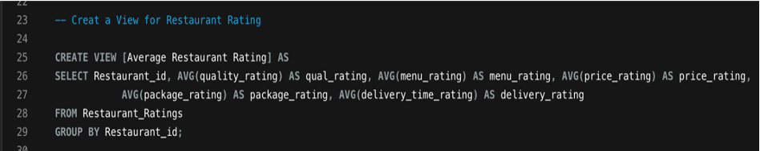
Views Created to the CampusEats Database Model
-A SQL view is a virtual table based on the result-set of an SQL statement. It contains rows and columns, just like a real table.
-The fields in a view table are fields from one or more real tables in the database.

Slide 12
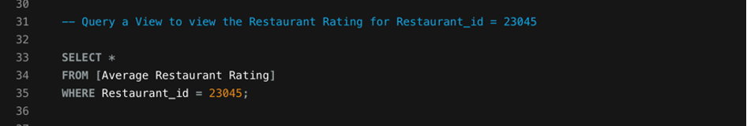
-Users can also add custom fields by using functions to gather the desired value for the fields.​
-Users can add SQL statements and functions to a view and present the data as if the data were coming from one single table.​

Slide 13
Indexes for Reports:
A SQL Index is Data Structure that contains organized copy from one or more of the tables in the database. It is the single most important tool available to a database administrator for improving query performance.
Example of query optimization:
Linear Search: Randomly Organized Names
Average search time:
· repeating the process of a search, ex.
· Linear search in list of names.
Linear search:
· Average search time = (n+1)/2 where n is the number of rows
· Maximum search time = n

Slide 14
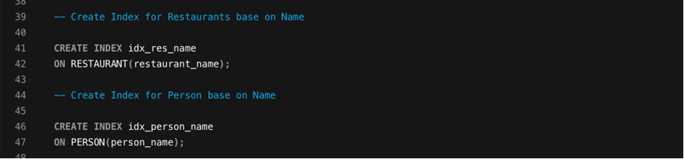
Binary Search:
Alphabetical Ordered Names
Since we have a sorted list, we can use a Binary Search or Divide and Conquer. Average search time:
Average = log2(n)· Maximum search time is log2(n)

Slide 15
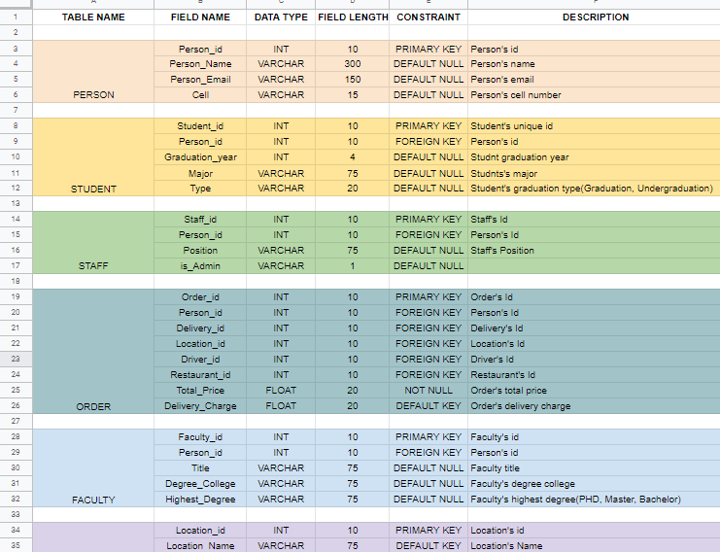
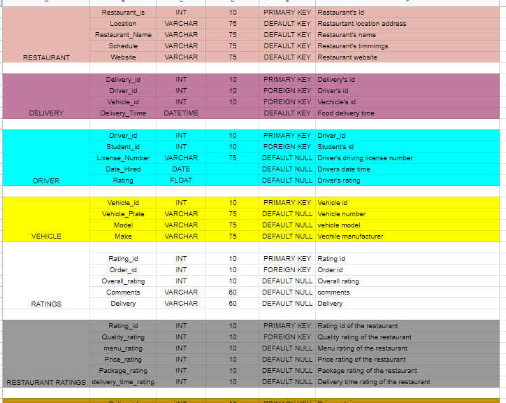
Data Dictionary
Our data dictionary shows the relationships between data, and show it relates to each other.
We keep track of things such as the types of data, group relationships grouped by person, student, staff, restaurant, delivery.
This helps us to give a general overview of what the database is composed of.

Slide 16
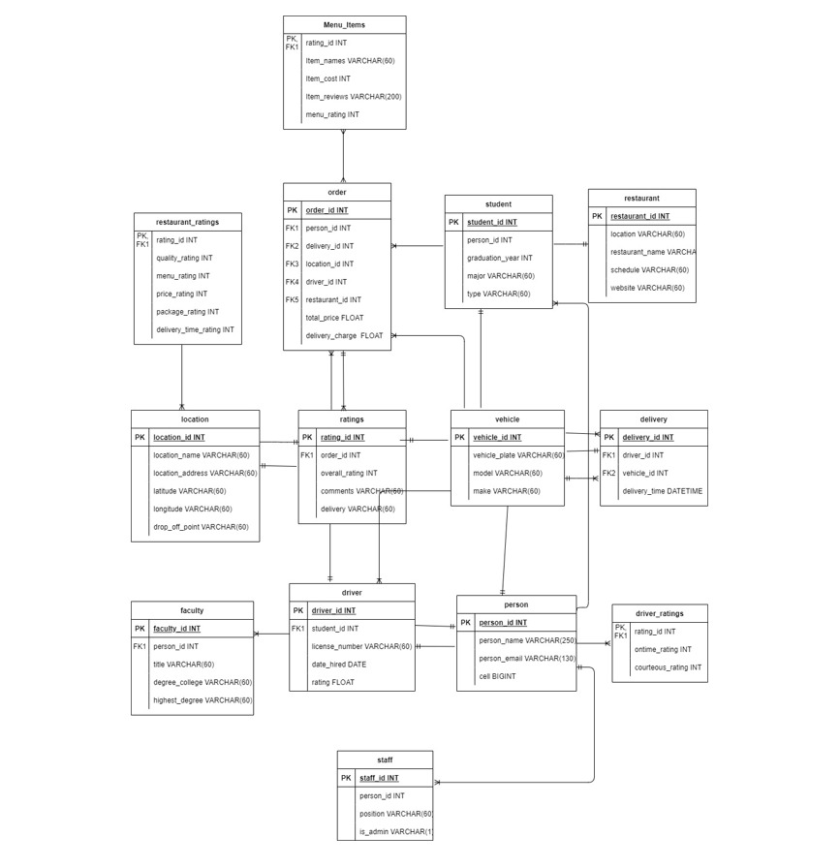
EERD
Our EERD Shows how all our different tables are interrelated to one another.
For example, how ratings are broken down into menu ratings, restaurant ratings and driven ratings which are part of the order and so on as well as their variables within each table, as well as their types.

Slide 17
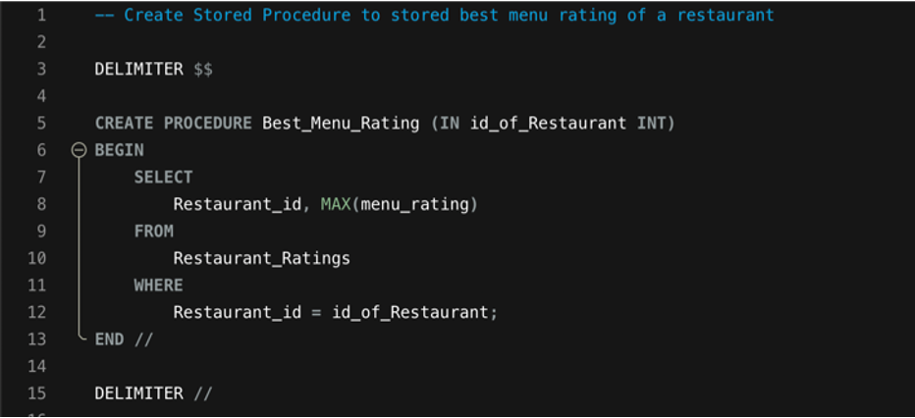
Stored Procedures
1. Best_Menu_Rating
Purpose: To get the best rating for the menu in the restaurant.
Input: Menu
Output: Rating

Slide 18
THANK YOU

